Slide 1

Marketing Strategy

Slide 2
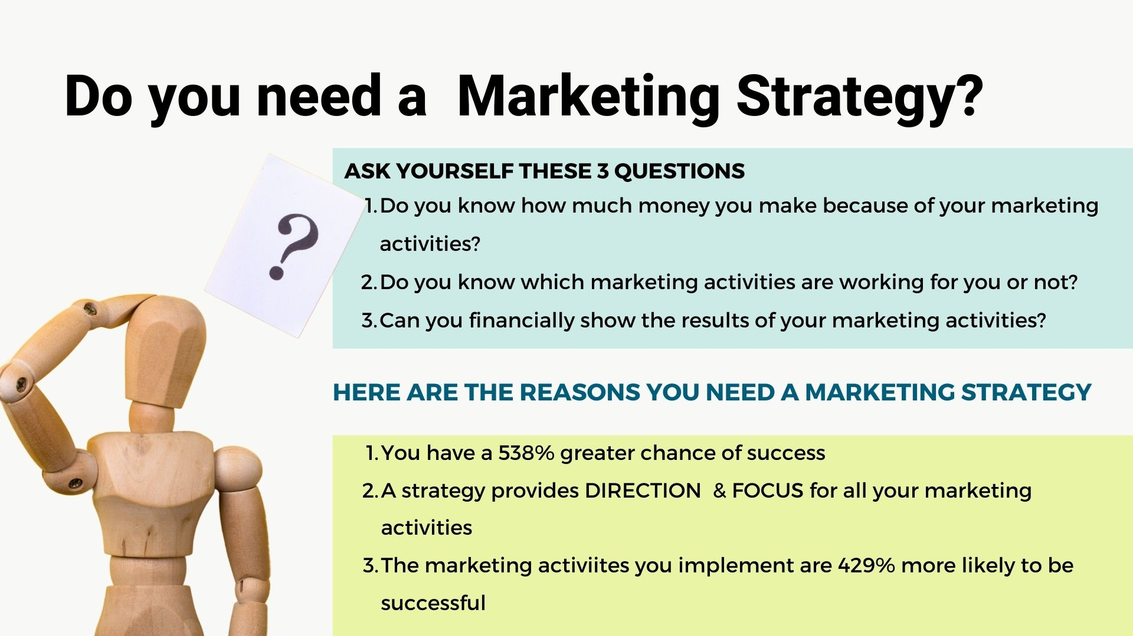

Slide 3
Marketing
ROAD MAP
3
HOW DO WE GET THERE?
Which actions are you going to take to reach your marketing goals
What messages do we need to develop to reach our target audience
2
SET YOUR DIRECTION
Highlight Strengths and Weaknesses of your practice
Understand where Opportunities and Threats exist
What do you want your customers to say about your practice?
Identify the marketing Goals for your practice
1
EXPLORE YOUR MARKET
Review the market you compete in
Market trends impacting your business
Your target customer
Your customer experience
Review your competitors

Slide 4
How to use this template
This template is divided into 3 sections
1. Explore your Market (Situational Analysis) – what does your product and the market currently look like
2. Set your Direction (Marketing Strategy) – this ties together all your thinking from the situational analysis and sets the direction for your marketing tactics
3. How you get There (Marketing Tactics) – this is your action plan for the next 12months and will include how you’ll measure and track your performance
  RESOURCES
We’ve added some ideas for places you can find resources to complete this slide
Each slide will explain what’s required to build your plan through the following icons and descriptions
  NOTE
We’ve added a note to provide advice on how to complete this section efficiently
OBJECTIVE – what do you want to achieve with this page
KEY TAKEAWAY – Highlight one or two elements of your findings that will have the highest impact on your business

Slide 5
Explore your
market
EXPLORE YOUR MARKET
Review the market you compete in
Market trends impacting your business
Your target customer
Your customer experience
Review your competitors
1

Slide 6
Market Review
Market Buying Patterns
Is your market seasonal or peak traffic days
    OBJECTIVE
Research the state of the industry/market in which you compete
Examine your target market demographics e.g. Target age, sex, race, family status and behaviors
Buying behavior e.g. Popular days or time of the year
Target region e.g. Local or global
  RESOURCES
Industry organizations
Online demographic data
KEY TAKEAWAY
Key observations that you feel will have the highest impact on your business.
% of business and behavior.

Slide 7
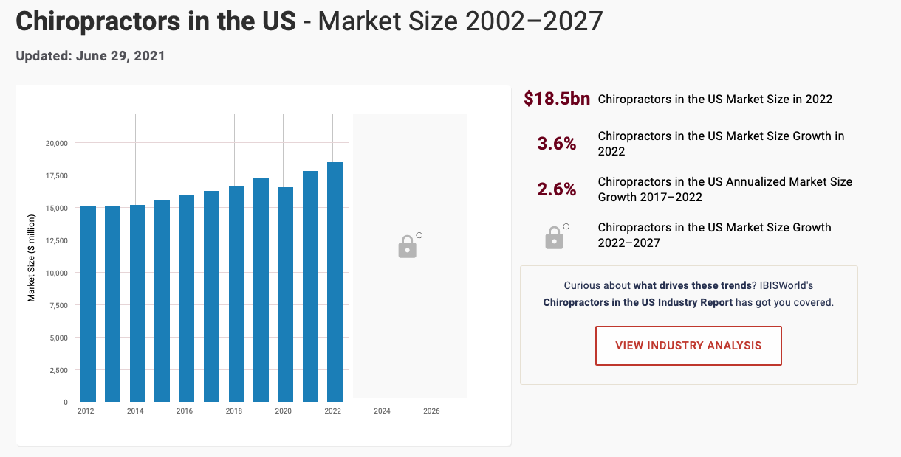
Sample Market Review
CHIROPRACTIC MARKET (global not specific to local areas) ¹
Chiropractor market in the US 2022 is predicted to be worth
18.5bn. 3.6% growth expected in 2022
The Chiropractor market is growing faster than the overall healthcare industry or economy.
Globally, Chiropractic services are well established in North America, UK and Australia.²
In comparison to similar rehabilitation professions such as physiotherapy, the chiropractic workforce is relatively small. This may partly be due to the education of physiotherapists, which is often incorporated in the faculty of medicine or rehabilitation sciences of major universities as opposed to the chiropractic education, which is predominantly offered at independent schools or colleges,
Growth is driven by increased spending on “wellness” and as people age, they are developing physical conditions that are treated effectively by a Chiropractor
Chiropractic Market US
FOCUS ON WELLNESS
Increased interest in wellness as we age, bolstered by COVID, will be a key driver for growth and opportunity for rehabilitation therapies

Slide 8
Market trends
    OBJECTIVE
Identify the top 10 trends in your industry and map them here
Evaluate the size of impact to your business and the market your targeting
Work with your team to determine where each of the trends fit
Positive
  RESOURCES
Industry organizations
Interview with target audience
Your team or customers
Fitness programs for older adults
Demand for online training
Neutral
Mobile
exercise apps
Body weight training
Size of impact on Market
Health/ Wellness coaching
HIIT
Exercise is Medicine
KEY TAKEAWAY
Wearable technology
Evaluate these trends and highlight 2-3 trends you want to either plan for or maximise in your business
Size of impact on my business
Impact on business
Positive
Negative

Slide 9

Target Customer
    OBJECTIVE
Outline in detail your target customer. Demographics
Describe your customer and their current role eg. Mother, student etc
Motivations/Values
What motivates your customer
Goals
Explain the goals of your target customer
Your Customer Story
Describe a day in the life of your customer utilizing their language describing their challenges
  RESOURCES
Social Media
Interviews with your customer
EXAMPLE
Demographics
Male/Female between age of 35-55 still extremely active and playing sport weekly
KEY TAKEAWAY
Goals
Remaining active is extremely important. They don’t want to be slowed down by injuries
What is the key reason this customer would be attracted to your product/service
Training with friends but remaining competitive is a great release from their professional job. Staying healthy & fit is part of who they are

Slide 10

Customer Journey
RESOURCES
Social Media Analytics
Google Analytics
E-commerce sites
OBJECTIVE
Below is an illustrative example and should be adapted so it’s unique to your business.
Capture both the behavior and data available to identify pain points (areas that require improvement
Awareness
Wait and See
Consideration
First Visit
Repeat Visit
Advocacy
The pain they’re feeling keeps returning and just won’t go away
They look online and see if they can self diagnose and find a solution to their problem
The realize it’s not getting better and seek help
Explain problem and seek diagnosis
Come back for further support and help
They recommend your practice to friends
Patient Behavior
Ignoring the problem and hoping it will resolve on its own
Google providing incorrect solutions
Explore many practitioners online using reviews to decide
Their explanation of the pain is poor
They want quick solution
It seems like they didn’t do home exercises correctly
Still frustrated
After multiple visits the problem has been resolved
Insights and Pain Points
Above is an abbreviated example, add as much details as you need
Highlight where patients feel frustration, and this can be explored in Step 2

Slide 11
Competitor review
 | Competitor A | Competitor B | Competitor C
Market Share
Customer Perception
Message
Price
Strength
Weakness
  RESOURCES
Social Media
Google Analytics and reviews
Competitor Websites
    OBJECTIVE
Deeply understanding your competitors so you can determine how to strategically compete. Include the following in your review
Customer Perception – what do customers think of your competitors e.g. Great advice and support
Market share or any analytical data you can view and compare
Key promotional messages
Pricing
Strengths and Weaknesses
KEY TAKEAWAY
Where do gaps currently exist in your market and where are the customers satisfied

Slide 12
Sample Competitor review
 | Competitor A | Competitor B | Competitor C
Market Share | 60% | 25% | 15%
Positioning | Veteran in the area – well known | New and dynamic for younger population | General practitioner
Message | No current promotion | Best for sport injury rehabilitation | Focus on older/mature patient rehabilitation
Price | -10% | Same | Same
Strength | Well established relationships with medical practitioners | Great position | Established with nursing homes near by
Weakness | Complacent, relies on current reputation | Lack of long-term care for patient/recycling through patients | Sole proprietor, very lean and stretched
The current area is competitive, but no one has a clear market identity or specialization
Our current practice needs to establish a clear identity, so patients know what to expect
Need to overcome habitual referring from medical physicians and help them understand our expertise
Gap exists to focus on specific niche and develop noise in the market

Slide 13
Building your
strategy
2
SET YOUR DIRECTION
Highlight strengths and weaknesses of your practice
Understand where Opportunities and Threats exist
How do you want customers to think about your practice
Identify the marketing Goals for your practice

Slide 14






LOOK INSIDE
for your Strengths and Weaknesses
LOOK OUTSIDE for Opportunities or Threats
STAFF
TRENDS
Staff feedback of ideas and obstacles
SWOT
What are trends in your environment that will impact your business
COMPETITORS
CUSTOMER
What activity is your competitor better than you. What are they doing differently
What has been their journey to find you and then examine their experience to identify areas of focus
INTERNAL METRICS
DEMOGRAPHICS
Internal metrics within
your business.
What does your target audience look like

Slide 15
SWOT
HIGHLIGHT THE TOP 2-5 FOR EACH ELEMENT OF THE SWOT
WEAKNESS
W
OPPORTUNITY
What are the weaknesses of your business e.g. Poor digital presence
O
An area that your business has the potential to satisfy e.g. product is current in high demand but poor supply
STRENGTH
S
THREATS
What are the strengths of you business e.g. Great customer service
T
An external challenge that could negatively impact your business

Slide 16
Sample SWOT
HIGHLIGHT THE TOP 2-5 FOR EACH ELEMENT OF THE SWOT
WEAKNESS
OPPORTUNITY
High competition from different specialty areas
Lack of awareness/exposure in local area
Lack of time/expertise to spend on marketing
Poor patient follow up
Customers lack clarity on our strengths
W
Increased focus on wellness and preventative care
Increased importance of physical activity of the local population
Wealthy, professional local population due to growing business area
O
S
T
STRENGTH
THREATS
Loyal patients due to superior experience
Passionate about continuous education
Strong, positive attitude of staff to embrace change
Foster caring/lasting relationships with patients
All therapists have a different specialty area
Changing political and insurance environment
Increased competition from young, aggressive therapists
New therapies impinging on our specialty area
Economic downturn and patients reducing spend

Slide 17


Building your strategy
OBJECTIVE
All the work you’ve done will lead you to discover great opportunities to grow your business but also areas the business will need to take swift action
CONCERN FOR THE BUISINESS
ACTIONABLE STRATEGY
Strong relationship between a weakness in your business and an external threat requires immediate attention.
Strong links between strength and opportunities create an environment to maximise growth

Slide 18
positioning
NOTE
OBJECTIVE
A positioning statement is used to align you messaging to your target audience and explains how your business is differentiated in the market
Now you understand the current situation of your business and market, it’s time to start planning for the future. You want to articulate how you want your product to differentiate itself in the mind of your customer? How would you like them to describe your business to a friend?
The below template will help shape your statement. Replace underlined areas with your specific strategy
  RESOURCES
Utilize everything you've leant, specifically the key takeaways from your situational analysis
For “your target customer” that “need your business addresses”, “your business” is the “define business category” that will “how does your business solve your customer’s need” so they can “benefit your product brings to the customer”
You positioning statement will describe your niche audience “target customer” and differentiate your business through “how does your business solve your customer need”

Slide 19
Example marketing strategy - positioning
This may seem cumbersome but when you complete the activity, you will defined exactly what your business does and how you serve your patients. This activity will provide you with focus and direction for all your activities moving forward
1.Target Customer
2. Needs your business addresses
For patients suffering chronic inflammatory diseases that need support to live a rewarding, fulfilling life. Because of XYZ’s is are a healthcare network of nurturing experts, we will elevate the support you need to remain active as you live your best life
3.Your Business
4. Define business category
5.Solve your customer’s need
6. Benefit to the customer

Slide 20
Goals
NOTE
OBJECTIVE OF GOALS
You only need 3-4 goals
Set goals for 12 months and ensure you track regularly throughout the year
Your goals are the key areas you need to focus on to ensure you meet your positioning target. These are vital to successfully meet your business strategy
Your goals are objectives of the highest priority that will shape your marketing action plan.
Your goals will act as your guardrails and direct what marketing activities you will do and those you will decline

Slide 21
Example marketing strategy- Goals
POSITIONING
For patients suffering chronic inflammatory diseases that need support to live a rewarding, fulfilling life. Because of XYZ’s is are a healthcare network of nurturing experts, we will elevate the support you need to remain active as you live your best life
GOALS
Build a targeted marketing campaign that differentiates XYZ in the market to attract new new patients
Develop a professional relationship with medical experts and advocate community through educational promotion
Build an online presence that represents our expertise

Slide 22
Marketing
Action plan
3
HOW DO WE GET THERE?
Which actions are you going to take to reach your marketing goals
What are the key messages that represent your business and resonate with your target customer

Slide 23
Tactics or Action plan
NOTE
OBJECTIVE OF ACTION PLAN
Aqua Blue Marketing would recommend you brainstorm ideas to create your action plan
Take a step back and prioritize based on the following
Budget
Time requirement
Target Audience/Customer receptivity
Your action plan is what will drive all your activity for the year.
This is where you’ll track how you’re preforming and adjust as required
Just because an idea sounds great, you need to ensure it will help you reach your goals.
You’re exploration of the market will provide you with ideas for your action plan and inform which channels your target audience utilize and what they’re receptive to.
Your action plan should be SMART – Specific, Measurable, Attainable, Relevant and Time bound
  RESOURCES
A project planning system with help you enormously to track you action plan
Never be afraid to throw an idea out if you see it’s not working.
You can be agile and adapt as necessary.
This is the power of a great marketing plan

Slide 24
Example tactical plan
Build a targeted marketing campaign that differentiates XYZ in the market to attract new patients
Develop a professional relationship with the 5 medical experts and the advocate community through educational promotion
Build an online presence that represents our expertise
Develop promotional messages and graphics for:
  Medical Professionals
  Patients
  Advocacy Groups
Establish presence on google business
Develop a customer review and feedback process
Develop a target list of medical practices & advocacy groups
Run online educational sessions for targeted medical and advocacy community
Form partnership with advocacy groups offering education to clients
Examine & Develop social channels where our target customers frequent
Overhaul website to show our expertise with a focus on the online patient experience
Develop online educational material for advocacy groups to utilize

Slide 25
Example one page marketing plan
For patients suffering chronic inflammatory or neurological diseases that need support to live a rewarding, fulfilling life. XYZ will elevate your support because of our nurturing advice and expertise will support you to remain active as you successfully live your best life
POSITIONING
Build a targeted marketing campaign that differentiates us in the market and attract clients to our business
Build strong relationship with the relevant medical and advocacy community to educate about our area of expertise and support their patients
Build an online presence that represents our expertise
GOALS
Develop targeted messages for different customer types
Build google business presence
Build patient reviews for all digital material
Develop a target list of medical practices & educational newsletter
Run online educational sessions for targeted medical and advocacy community
Form partnership with advocacy groups offering education to clients
Examine social channels where our target customers frequent
Build social presence on these two channels
Overhaul website to show our expertise with a focus on the online patient experience
TACTICS

Slide 26
messages
17
NOTE
OBJECTIVE
Articulate your long form key messages that form the backbone of your promotional activity
These messages will be adjusted for different channels
There are many ways to create irresistible messages and I’d encourage you to spend the time perfecting these message
Outline the following:
  Utilize your target customer as highlighted earlier in the plan
  Identify the problem that your target customer experiences utilizing their language and emotion
  Describe the solution to the problem and how you offer support
  Show how you have improved the experience for your customers
  How are you different from your competitors
If you’ve taken the time to both listen and truly understand your customer experience, messaging will be easier to develop
You’re messages need to be crafted in a compelling way that helps your customer feel comfortable about the change you’re asking them to make
Take the time to test your messages with your target audience
  RESOURCES
Target Customer
Customer Experience Map
Brand Strengths
Potential support www.tamsenwebster.com

Slide 27




Measuring
success
or KPIs
AWARENESS
This can be walk in traffic or phone enquires to digital impressions
Bounce Rate
The customer is aware but doesn’t seem to even consider your business
CONSIDERATION
OBJECTIVE
THE MARKETING FUNNEL
Customers are considering a purchase. – talked to a sales rep. or added product to their cart
Lead to conversion
Rate at which customers move from consideration to purchase
A marketing funnel tracks potential customers throughout their purchase journey from awareness through to purchasing.
The funnel should be specific to your business and is measuring customer engagement at each phase
PURCHASE
Actively purchased a product from you
Return on Investment
How much did you spend vs the sales from this campaign
LOYALTY
These are your advocates that are repeat purchasing your product
Customer Lifetime Value
How much did you spend to maintain the relationship with this customer

Slide 28
BUYING
FUNNEL
TYPES OF ADVERTISING
AWARENESS
Website Display advertising
General Social Media Advertising
Commitment is low,
Awareness of need is low
OBJECTIVE: Brand Awareness
Google Ad Words
Targeted Social Media Advertising
Email
CONSIDERATION
Representing potential advertising opportunities across the buyer funnel will help understand the potential opportunity
Highest return on investment will be seen at the “consideration” and “convert” phase as the customer has decided they want to buy a brush
Awareness will always be a lower return on investment as you’re creating awareness of the need and your brand. You’re trying to hook the person who maybe thinking about a brush but hasn’t started looking yet
Commitment is medium,
Awareness of need is high
OBJECTIVE: Brand Preference
Google Ad Words
Email
Retargeted advertising
CONVERT
Commitment is high
Brand Awareness High
OBJECTIVE: Purchase
Email
Social Media Followers promotion
Personal discussions
RETENTION
Commitment is HIGH,
Convert and Repeated purchase
OBJECTIVE: Advocate

Slide 29
Example KPIs
Goals | Tactics | KPI | Timeline | Resp.
Build a targeted marketing campaign that differentiates XYZ in the market to attract new patients | Develop promotional messages and graphics | Develop 3 unique messages & visuals for Medical Prof. Advocacy Patient | Developed within 1month | XYZ
 | Establish presence on google business | Build business profile on google Ensure position 1 on google AdWords for local region | Developed within 1month Google AdWords measured monthly | XYZ
 | Develop a customer review process | 10 patient leave google review averaging 4.5 Interview 10 patients for reviews for website | Review google monthly To be completed within 6 months | XYZ

Slide 30
“The Power of a great marketing plan is the ability to identify if your off track and adjust”

Slide 31
THANKYOU
Further support at contact@AquaBlueMarketing.com

